Slide 1
324103210046
Elaprolu Jnapika Chowdary
CSE-1
GROUP-6
K.Rohini Mam
FOC
CSE-1

Slide 2
Contents
Introduction to computer memory
Types of memory
Differences between memory
Upgrading your RAM
Memory organization
Memory hierarchy
Internal memory
Differences between sequential and random access memory
Cache memory
Basic organization of cache memory

Slide 3
COMPUTER MEMORY
Computer memory is a fundamental component of a computer system ,serving as a storage for data and instructions that the processor can quickly access understanding the various aspects of a computer memory. It is crucial for designing efficient systems and optimizing performance.

Slide 4
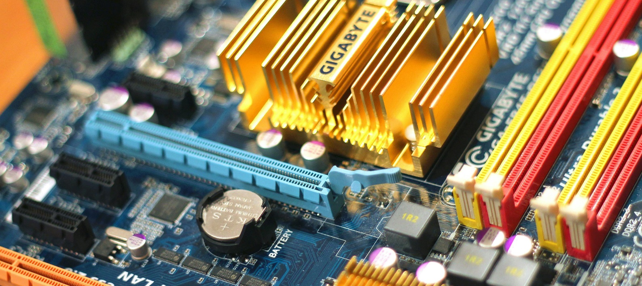
INTRODUCTION TO COMPUTER MEMORY
It stores data either temporarily or permanently. It plays a crucial role in allowing CPU to access data and instructions rapidly.
They are two types of computer memory
1.Primary memory
2.Secondary memory

Slide 5
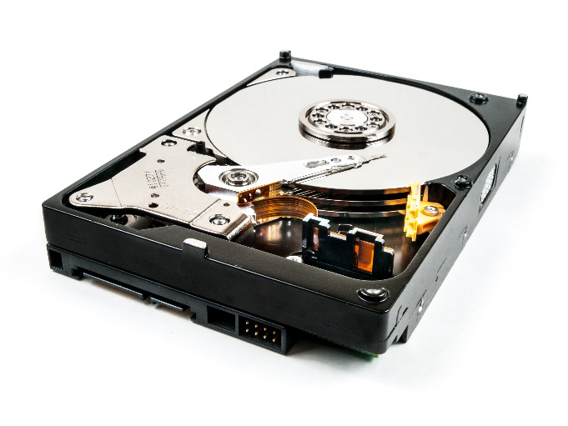
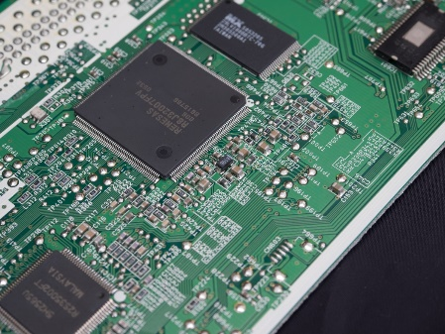
Difference Between Memory
Primary memory
Secondary memory
Also known as main memory
Includes RAM & ROM
Provides short term storage
Temporary storage memory
Very expensive
Also known as permanent memory
Includes hard disk ,FDD ,CD drive etc..
Provides long term storage
Very cheap

Slide 6
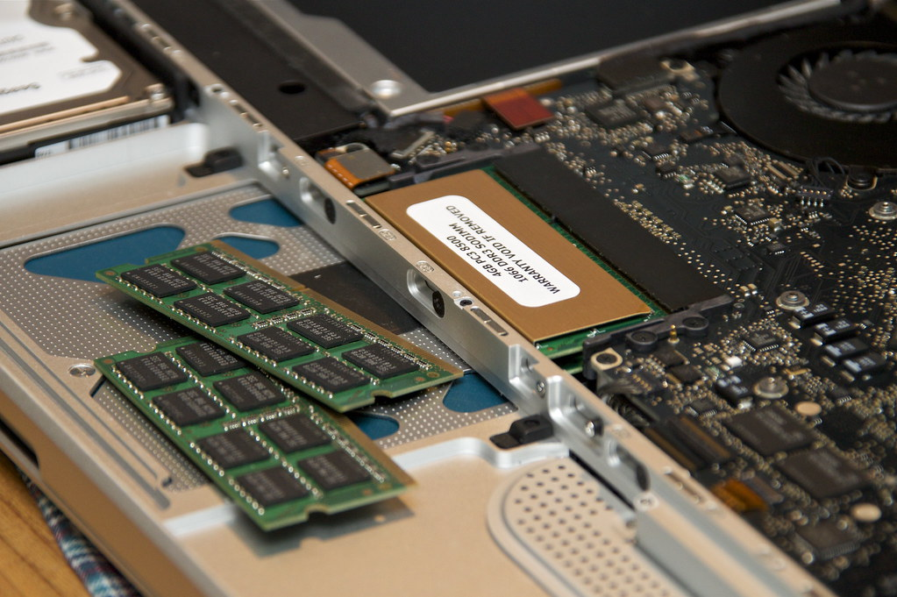
Upgrade your RAM
RAM
One of the simplest way to enhance performance is by upgrading your RAM. More memory allows f0r better multitasking and faster data access, significantly improving system speed.

Slide 7
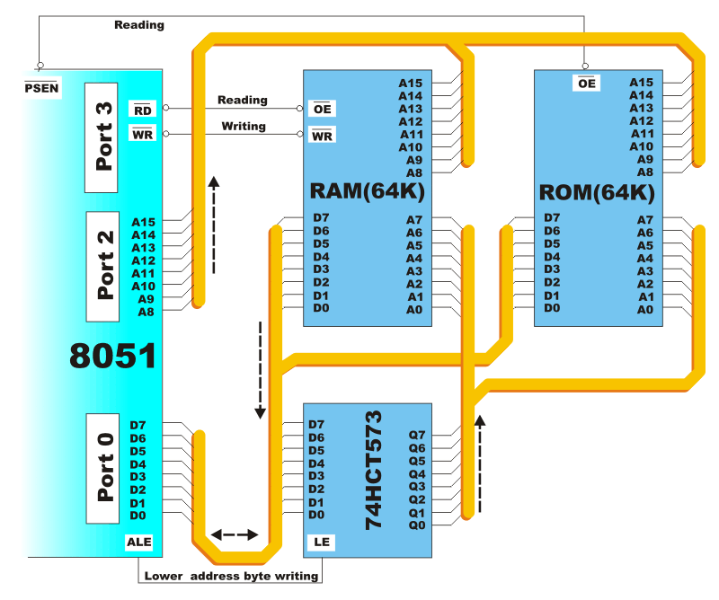
MEMORY ORGANISATION
Pertains to the structure and arrangement of memory cells in a memory devices.
Memory cells: the basic unit of memory that stores bits of data.
Addressing mode: Techniques used to access data stored in memory common addressing modes include direct, indirect and indexed addressing.
Memory modules: Physical units of multiple memory chips that can be installed in a computer to expand its memory capacity.

Slide 8
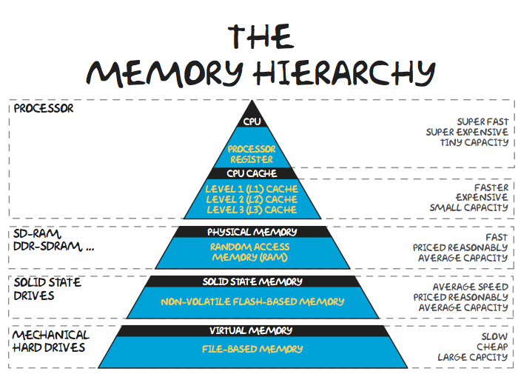
Memory Hierarchy
It is the structured arrangement of memory types in a computer
Small unit of memory is bit. Bit can have values as 0 or 1.
When a bit is set its value as 1 and reset as 0.
The memory is organized in the form of a cell, each cell is able to be identified with a unique number called address.
When each cell is able to recognize control signals such as read an write, generated by CPU.
Whenever CPU executes the program there Is a need to transfer the instruction from the memory to CPU. Because , the program is available in memory. To access instruction CPU generates the memory request.

Slide 9
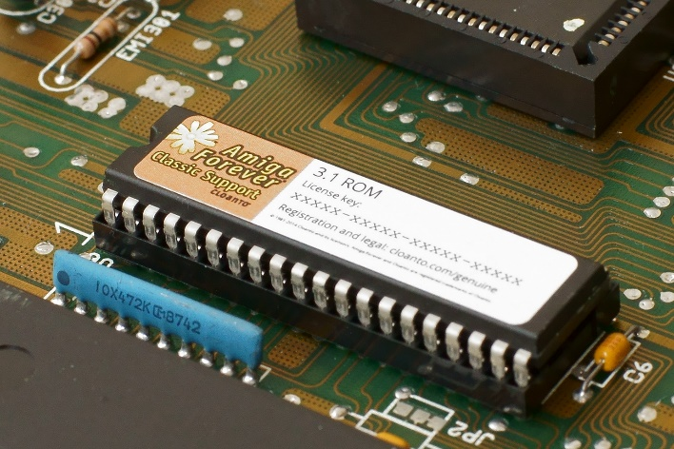
INTERNAL MEMORY
ROM : it is non-volatile memory , we can only read the programs and data stored in it. It is also known as primary memory . ROM memory is represented in MB.

Slide 10
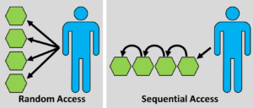
Differences Between
SEQUENTIAL ACCESS MEMORY
RANDOM ACCESS MEMORY
Takes more time to work
Memory accessed in sequential manner.
Uses program counter to store memory
Takes less time to work
Memory accessed in random order
Uses registers to store memory

Slide 11
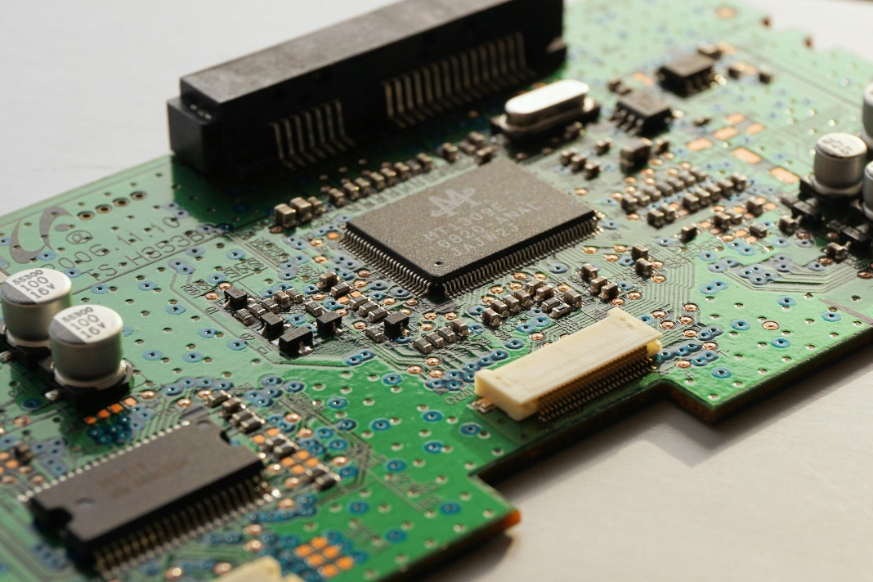
CACHE MEMORY
It is a chip-based memory of computer component. It acts as temporary storage area that computers can retrieve data from easily.
Frequently used memory by CPU is called cache memory. It can access the data in shorter time. If no memory found.
Then the CPU moves into main memory. Word is collection of bytes.

Slide 12
BASIC ORGANISATION OF CACHE MEMORY
The performance of the cache memory is frequently measured in terms of a quantity called hit ratio. when the CPU refers to memory and finds the word in cache it is said to produce a hit.
If the word is not found in cache, it is in main memory and counts as a miss. The ratio of the number of hits divided by the total CPU references to memory is the hit ratio.

